Slide 1
Face Recognition Based Attendance System
Done By:
Mok Wen Jun
Supervisor:
Dr Althea Liang Qianhui
Examiner:
Assoc/Prof Deepu Rajan
Date: November 30, 2018

Slide 2
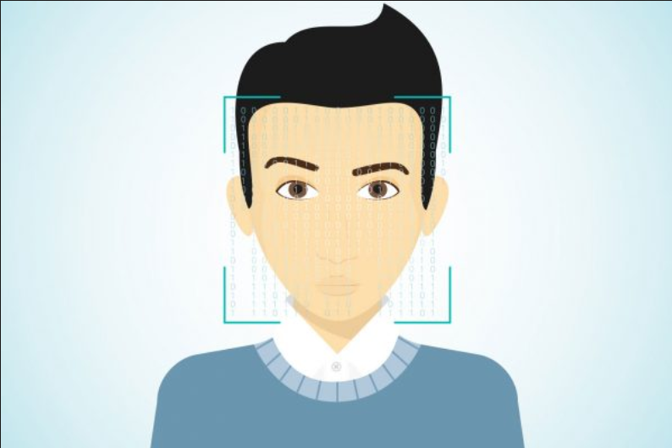
Face recognition Systems
Identify or verify an individual’s identity
Important in many computer vision applications

Slide 3

Statement of Problem
Attendance plays an important role in our education system

Slide 4

Traditional methods of attendance taking:
Pass the attendance sheet around

Slide 5

Call out names of the students individually

Slide 6
Problems which might arise
Consume a lot of time
Prone to errors

Slide 7
Project Objective
Take the attendance of students in the classroom
Camera is placed at the entrance
Can choose to register attendance individually or as a group of up to five students

Slide 8
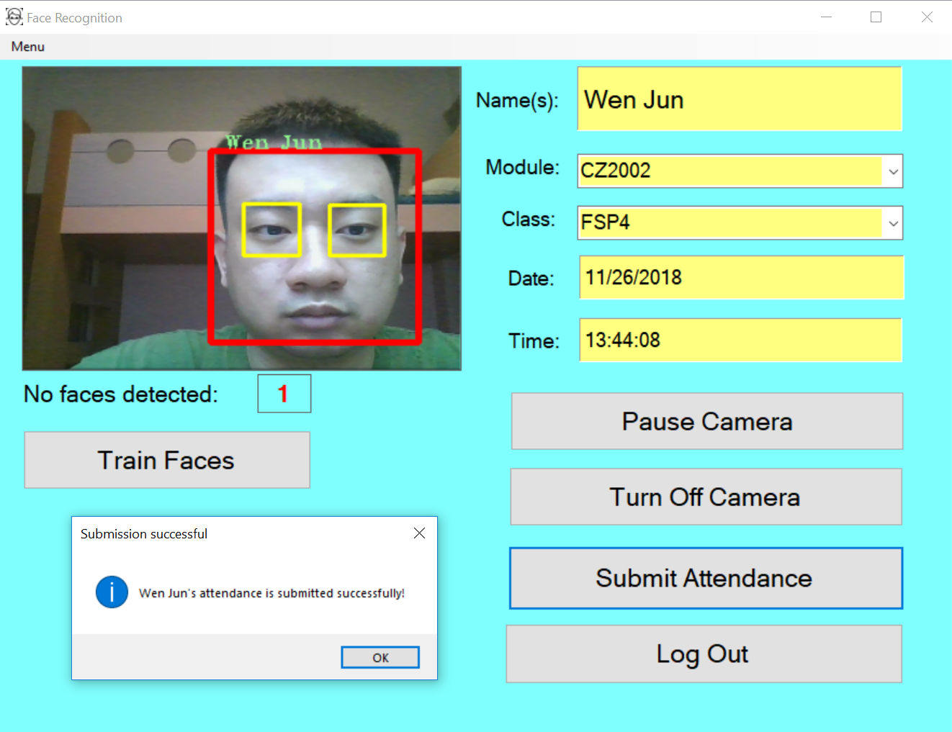
Methods which students can take their attendance
Students take their attendance individually

Slide 9
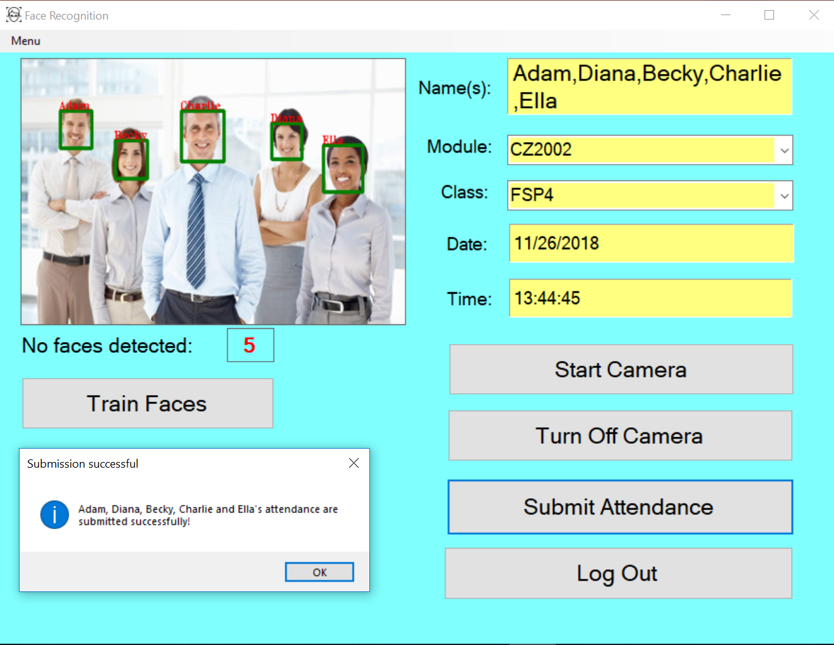
Methods which students can take their attendance
Students take their attendance as a group

Slide 10
Face recognition based attendance system
Detected using Viola Jones object detection framework
Detected faces are being extracted
Compared with training images with matching features
Rectangle drawn around the detected student’s face
The name (label) corresponding to the recognized face will be placed outside the rectangle of the detected face

Slide 11
Face recognition based attendance system
If the submission is successful, an “Attendance Submitted Successfully” message will be read by the voice conversion system.
Students’ attendance stored into the database.
Teachers are able to view, modify and update the attendance records
Able to insert students’ attendance records manually if they are not captured by the system

Slide 12


Slide 13

Export Attendance Records into an excel sheet

Slide 14

Exception - UNKNOWN face detected

Slide 15

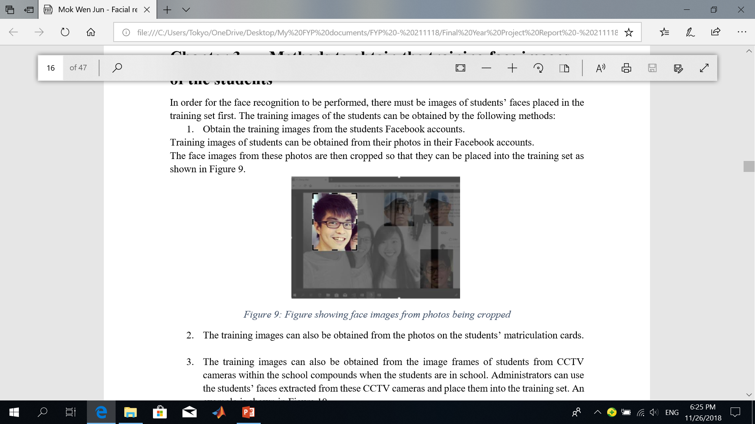
Methods to obtain training face images of students
Obtain the training face images from the students Facebook accounts

Slide 16
Methods to obtain training face images of students
Getting students to look into the camera to get their training faces extracted and placed into the training set.
Different orientations, positions, lighting conditions and expressions of the faces as far as possible

Slide 17
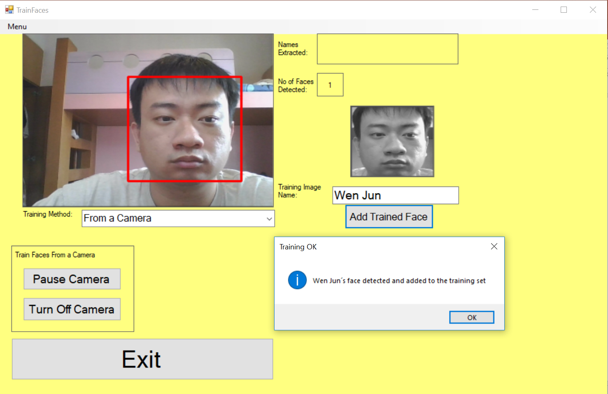
1. Look into the camera for the face to be detected
2. Key in the name of the training image
3. Add the trained face into the training set

Slide 18
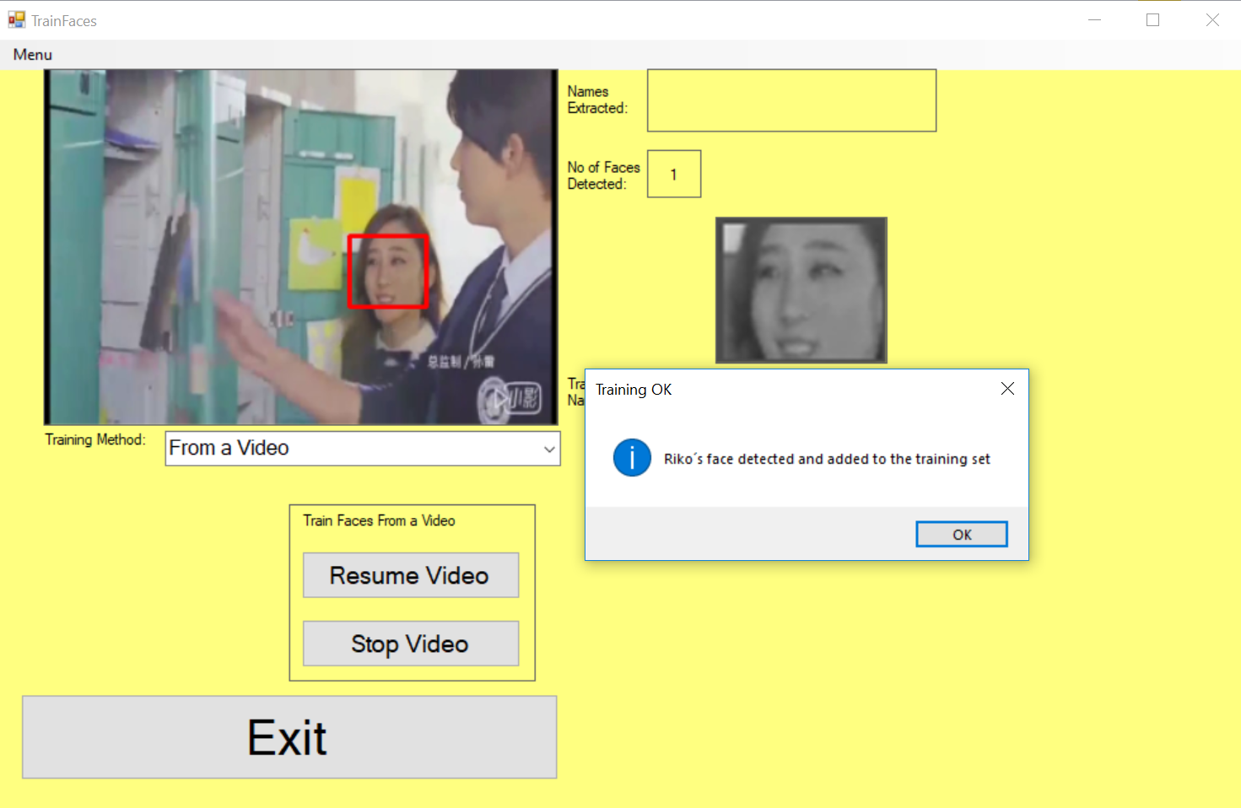
Methods to obtain training face images of students
Obtain the training face images from the image frames of students from CCTV cameras

Slide 19
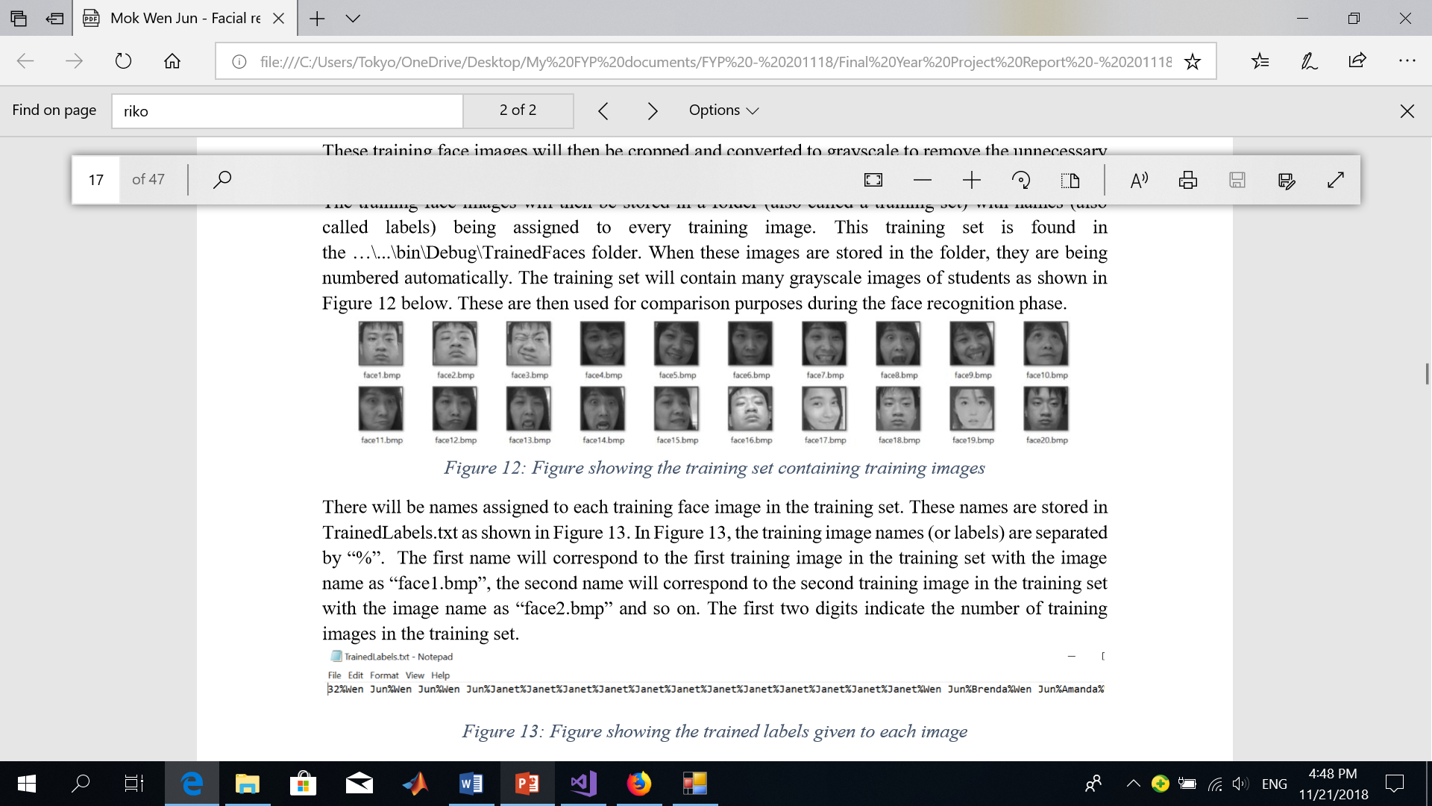

Training face images are cropped, converted to grayscale
Stored in a folder with names assigned to every training image

Slide 20
Names are assigned to each training face image in the training set
Training image names (or labels) are separated by “%”.
The first two digits indicate the number of training images in the training set.

Slide 21
Techniques used in face recognition
Eigenfaces
Made up of a linear combination of weighted eigenvectors.
Eigenvectors are made up of the covariance matrix of a training image set.
Created from the statistical analysis of many images of faces.
E.g. A person’s face can be made up of 20% from Eigenface 1, 20% from Eigenface 2, 20% from Eigenface 3 and so on.
Created by dark and light areas arranged in a certain pattern

Slide 22
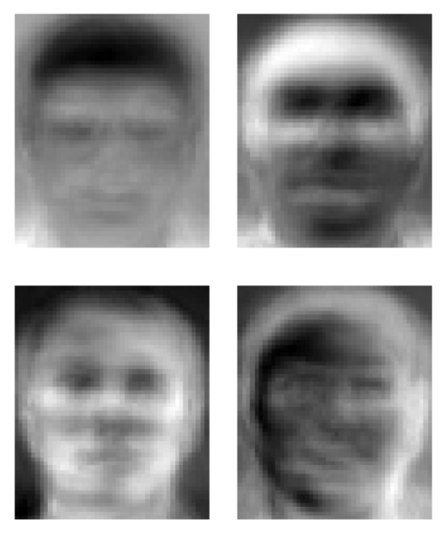

Slide 23


Libraries used

Slide 24
Problems to be addressed for low-resolution frames & images
Training images from student’s Facebook accounts and CCTV cameras might have been of low-resolution.
2. Low-resolution camera in the face recognition based attendance system makes face recognition more difficult.

Slide 25
Solution – Super Resolution
Students faces detected by the attendance system are re-constructed to a high resolution image
Improve the face recognition accuracy

Slide 26
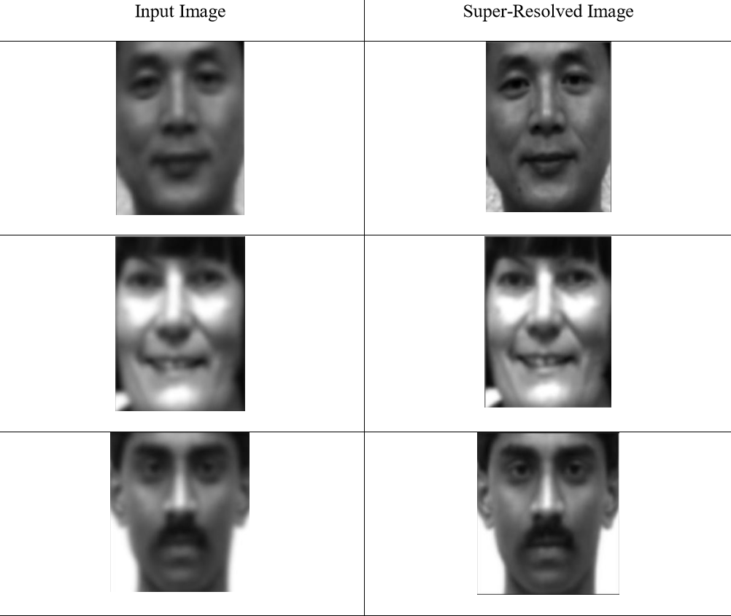

Slide 27
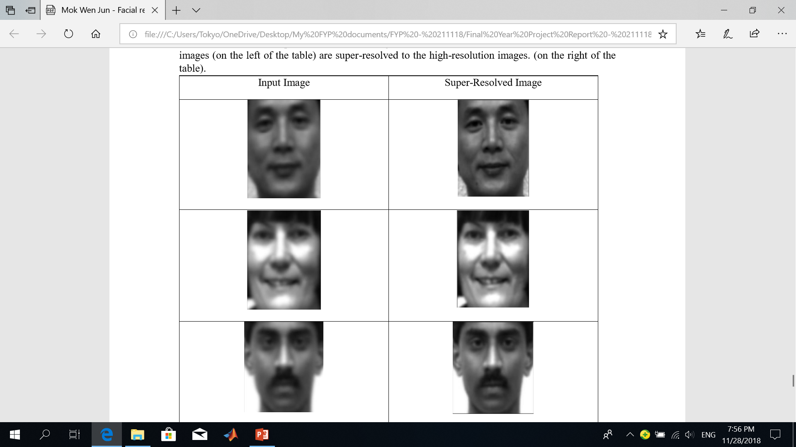
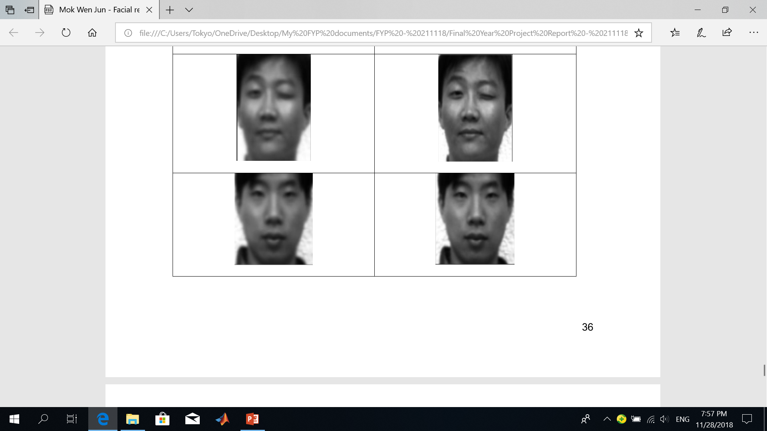

Slide 28
Experiment Set Up
Objective: To determine the factors such as the eigen distance threshold value, epsilon value and number of training images affect the face recognition accuracy as well as the face recognition speed.
No of identities: 20
No of training images per identity: 7
No of testing images per identity: 4
(15 identities are from the Yale Face Database. Remaining 5 identities are from my test subjects.)
Contains images of persons with different expressions, orientations, positions of the face and different lighting conditions.

Slide 29
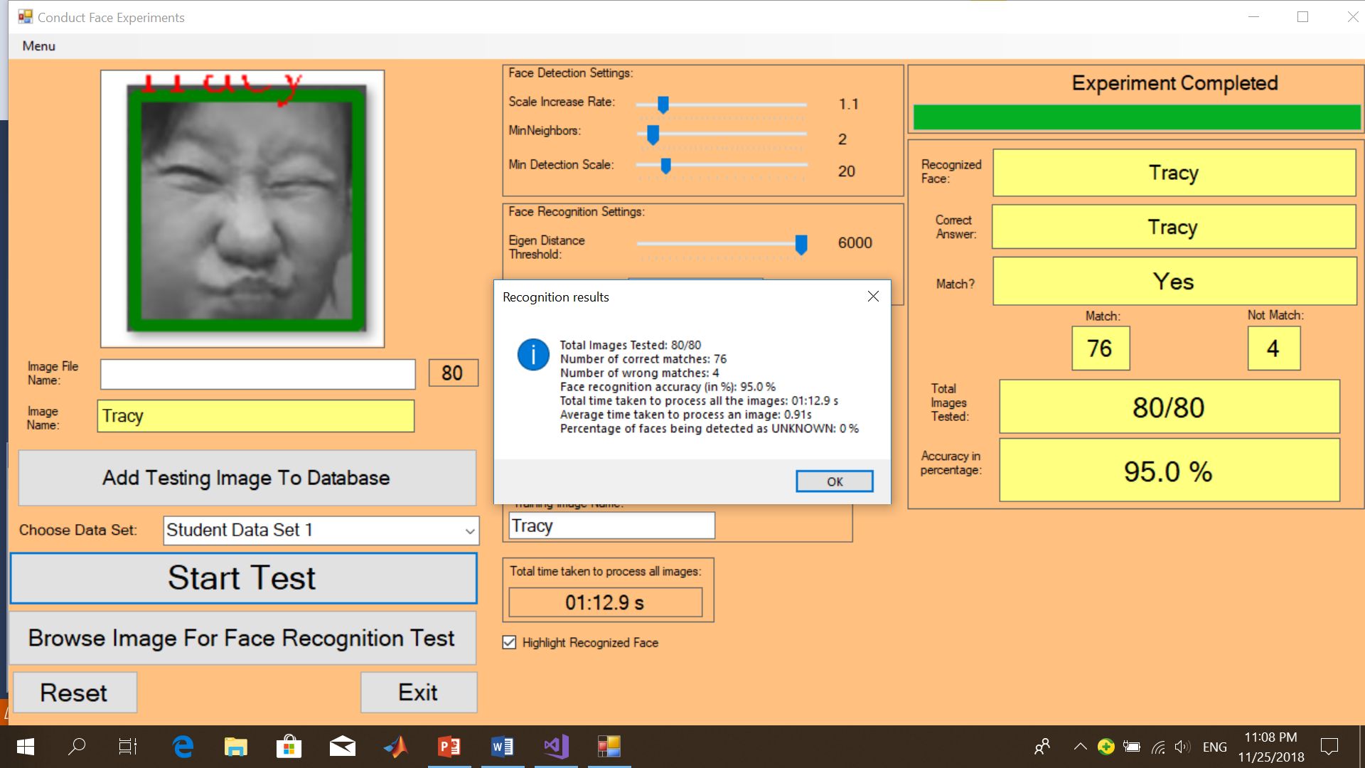
After the experiment is run on all 80 testing images
76 out of 80 faces detected correctly
Face recognition accuracy = 95%
Average time taken to process an image = 0.91s
Percentage of “UNKNOWN” faces = 0%

Slide 30
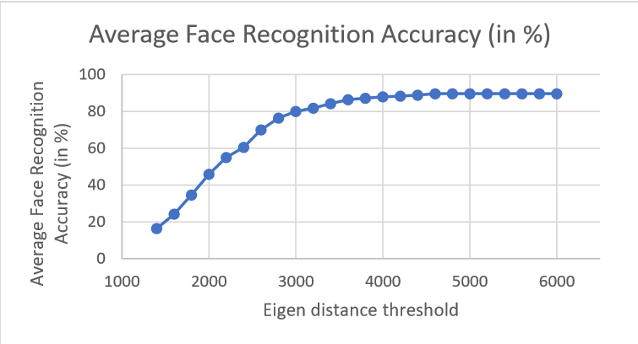
Experiment Results
Experiment 1: An increase in the Eigen Distance Threshold value results in the increase in face recognition accuracy

Slide 31
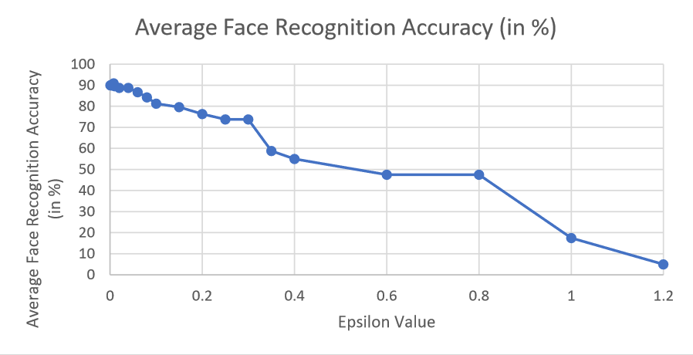
Experiment Results
Experiment 2: Decrease in the Epsilon values increases the face recognition accuracy.

Slide 32
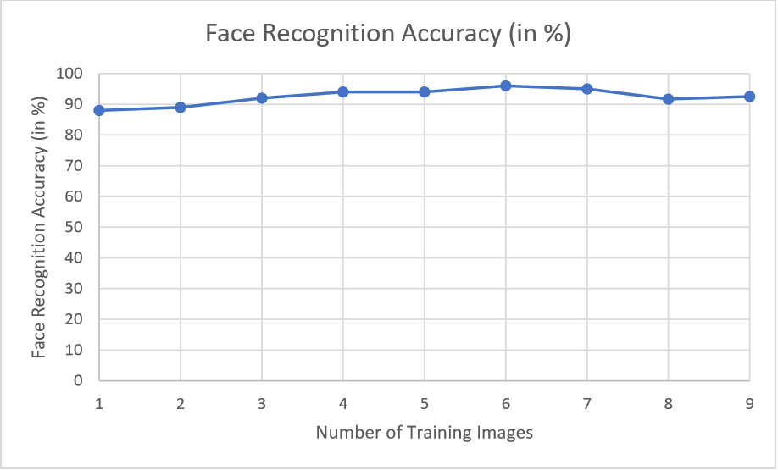
Experiment Results
Experiment 3: Increase in the number of training images for each person increases the face recognition accuracy

Slide 33

Experiment Results
Experiment 4: No relationship between the Eigen distance threshold values and the speed of face recognition

Slide 34
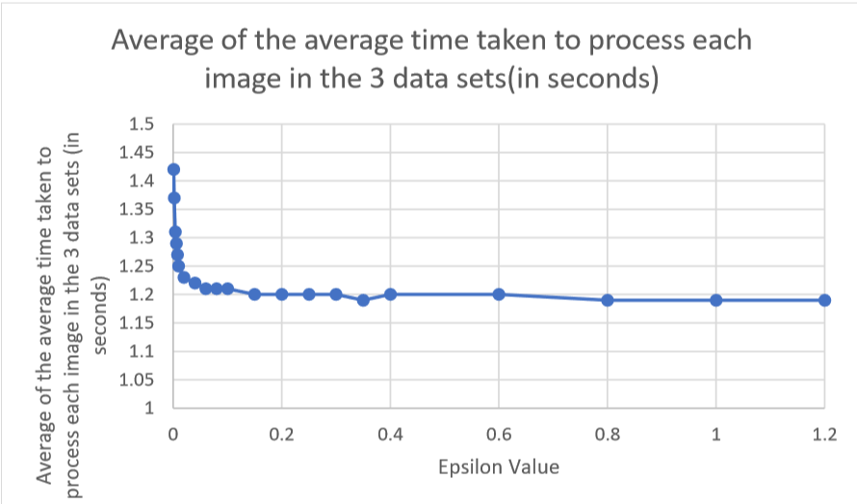
Experiment Results
Experiment 5: Increase in the epsilon values increases the face recognition speed

Slide 35
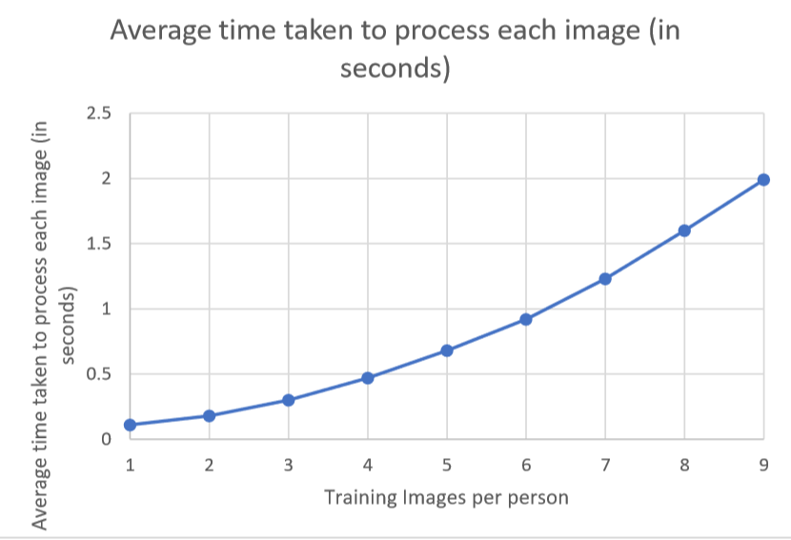
Experiment Results
Experiment 6: Increase in the number of training images decreases the face recognition speed

Slide 36
Optimal settings
Eigen distance threshold value = 6000
Epsilon value = 0.01
Number of training images = 6

Slide 37
Conclusion
Useful, efficient and convenient
Frees up teacher’s time to conduct lessons.
Saves time as up to five students can take their attendance at a time.
Prevents errors
Students are not able to sign the attendance of another student.

Slide 38
Future work
Further enhance to cater to the needs of new students who join the class
Increase speed of face recognition when there are a large number of training images
Mobile application used as a face recognition based attendance system
Further enhance to enable the teachers to monitor students attention in class

Slide 39


